Slide 1
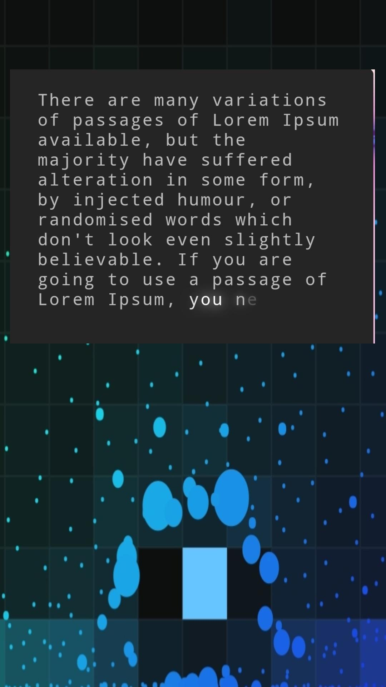
This text begins to write when you hold your finger on the screen.
Need a text box (text area), where text will be written.
The background should be all of those changing color squares, but without bubble particles.
https://codepen.io/jackrugile/pen/JLOXWZ
Needs to be done on circle, when you hold and circle finger then text writes.
https://codepen.io/captainbrosset/details/WbzGRw

Slide 2
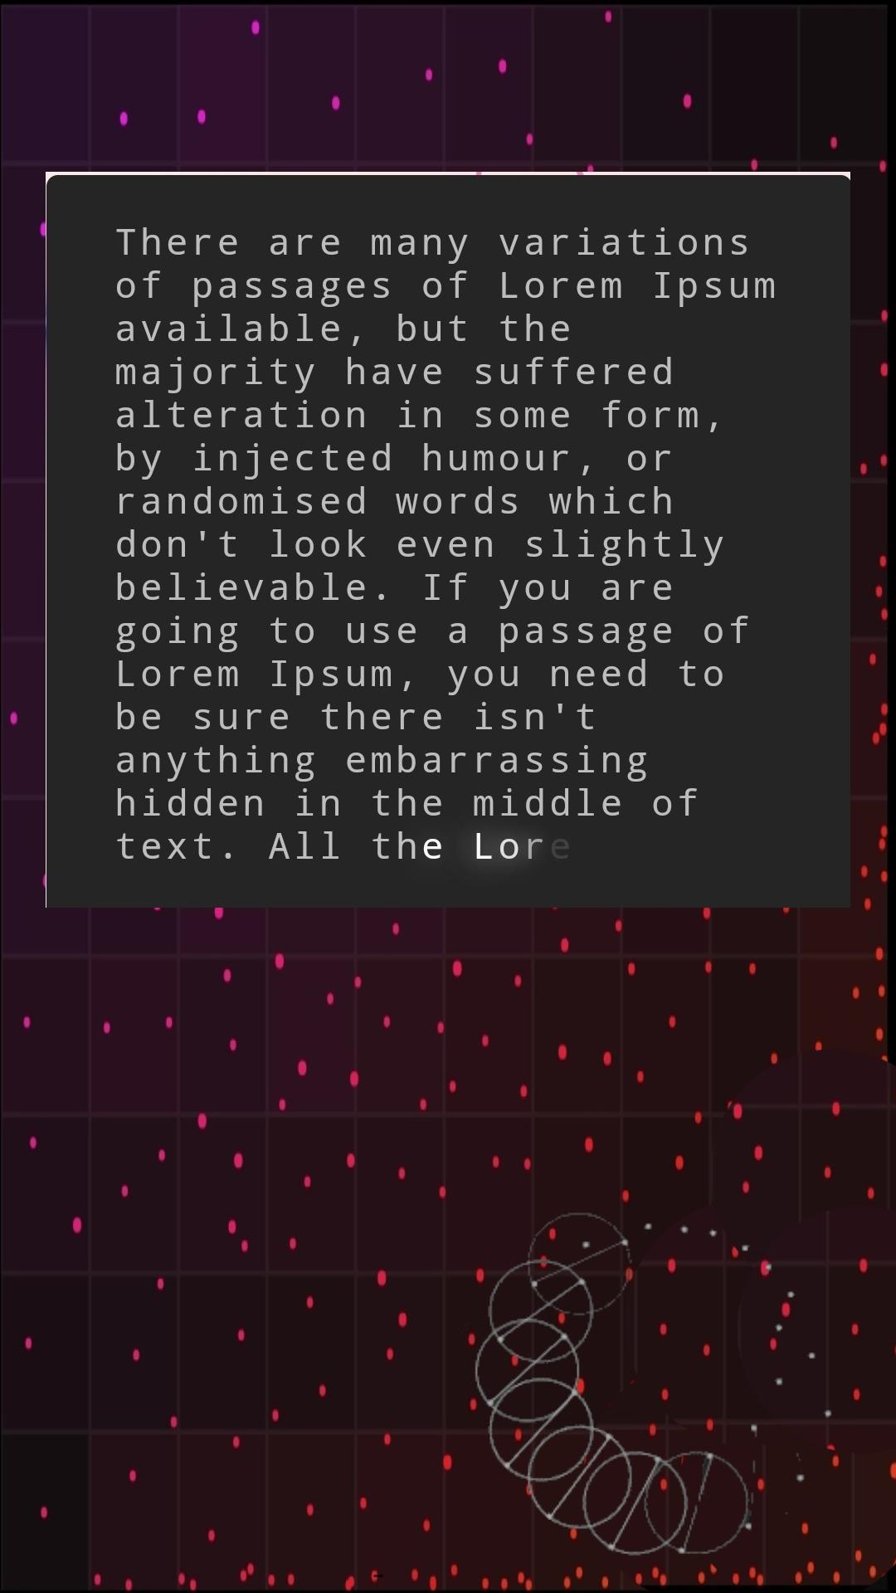
The finish sample of product must look like that.
If possible, background without the dots.
When you circle with the finger, text writes. And it should not stop, like on the codeopen, it has to be slowly circling.

